Slide 1

By
AKHIL ANILKUMAR

Slide 2
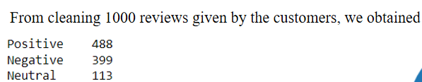
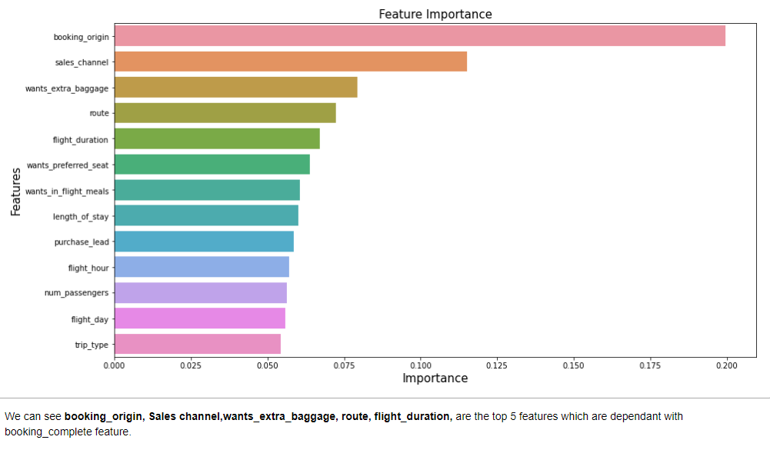
PREDICTIVE MODEL TO UNDERSTAND FACTORS THAT INFLUENCE BUYING BEHAVIOUR

